Slide 1

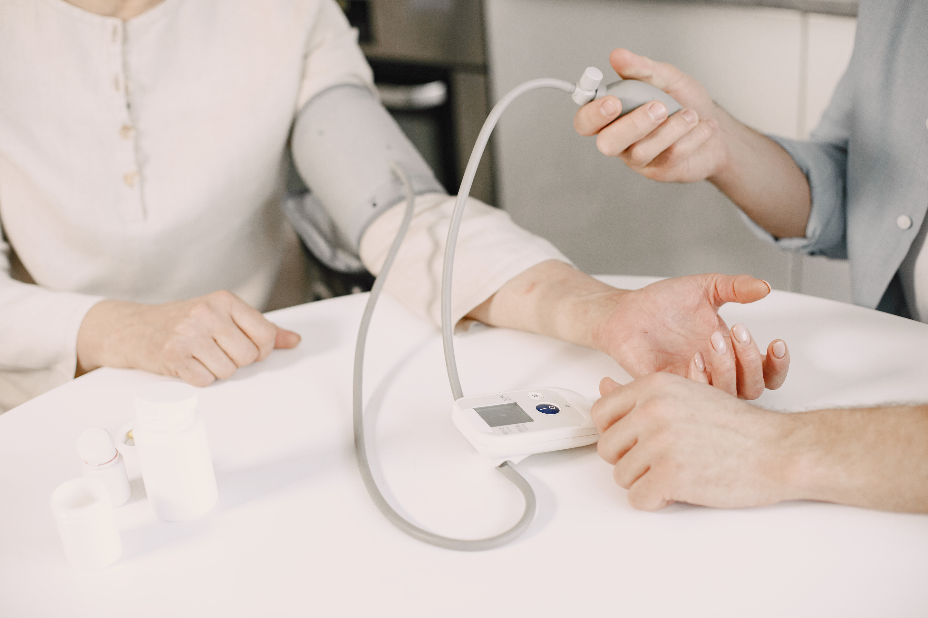


MyDoctor
One-stop solution for all Health Documents
www.mydoctor.com
care@mydoctor.com

Slide 2


What is MyDoctor ?
It is a digital platform where you can access all your medical / health documents.

Slide 3





Why Choose Us?
Fast, Secure and Easy Platform
Get your health documents
Get Medical advice
Get quick appointments

Slide 4






All the data is blockchain secured.
It has simple and easy user interface.
24 x 7 service available.
customer support available in regional language.
Fast , Secure and Easy Platform

Slide 5
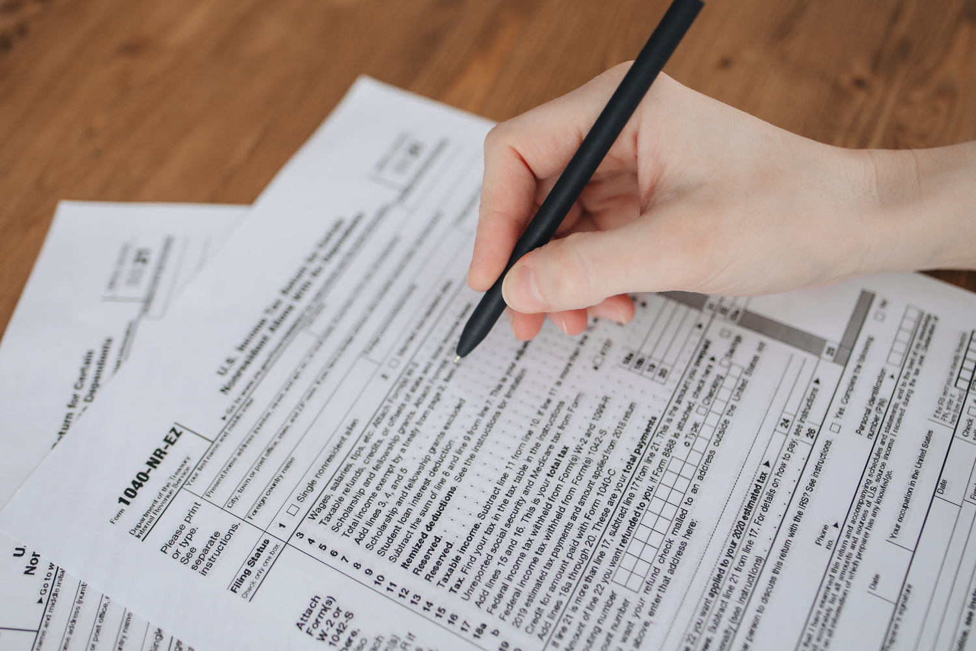

Get your health Documents.
Get your authenticated health documents when-ever and where-ever you need.

Slide 6

Get medical advice
Get personalised health advice from IMA certified Doctors

Slide 7

Get quick appointment
Book your appointment in two ways:-
1-Online mode (Video Call)
2-Offline (Meet in person)

Slide 8
Conclusion
MyDoctor stores your data and provides a convenient and efficient way for you to manage and access your health information.
It can help you track your medical history, schedule appointments, and receive reminders for medications and screenings. Overall, MyDoctor can be a useful tool for improving your overall healthcare experience.

Slide 9

THANK YOU
care@mydoctor.com
www.mydoctor.com

